Slide 1
Project Initiation

Slide 2

Key Ideas
Identifying business value
Feasibility analysis is used to aid in the decision of whether or not to proceed with the IS project.

Slide 3
Key Ideas
The project sponsor is a key person proposing development or adoption of the new information technology .
The approval committee reviews proposals from various groups and units in the organization and decides which to commit to developing.

Slide 4
IDENTIFYING BUSINESS VALUE

Slide 5

System Request
Lists key elements of the project
  Project name
  Project sponsor
  Business need
  Functionality
  Expected value
  Special issues or constraints

Slide 6
An ongoing-case study used to illustrate concepts presented in the text

Slide 7
System Request
Sponsor: Vice President
Business need: increase CD sales by
reaching Internet customers
Functionality: complete a purchase,
search for an item
place an order
receive an approval
Expected value: $2 m increase in sales
improved customer service
Special issues: system in pace in 7 months

Slide 8
FEASIBILITY ANALYSIS

Slide 9
Feasibility Analysis
Detailing Expected Costs and Benefits
  Technical feasibility
  Economic feasibility
  Organizational feasibility

Slide 10
Technical Feasibility:
Can We Build It? Risk Anal.
Familiarity with application
  Knowledge of business domain
Familiarity with technology
  Extension of existing firm technologies
Project size
  Number of people, time, and features

Slide 11
Economic Feasibility
Should We Build It?
Benefits
Development costs
Operational costs
Totals
Identify, Assign $, Cash flow, ROI

Slide 12
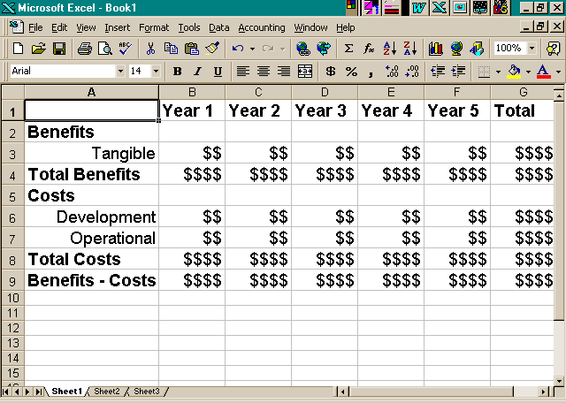
Cash Flow Method for Cost Benefit Analysis

Slide 13
Return on Investment Calculation
RETURN ON INVESTMENT EQUALS
Total (benefits - costs)
Divided by
Total costs

Slide 14
Organizational Feasibility
If we build it, will they come?
Stakeholder analysis
  Project champion(s)
  Organizational management
  System users

Slide 15
APPLYING THE CONCEPTS AT CD SELECTIONS

Slide 16
Technical Feasibility (low)
  Familiarity w app (low)
  Familiarity w Tech (low)
  Project size (moderate)
Economic Feasibility (excellent)
  High ROI and benefits
  Intangible benefits
Organizational Feasibility (excellent)
  Project Champion
  Management
  Users

Slide 17
Summary
Project initiation involves creating and assessing goals and expectations for a new system
Identifying the business value of the new project is a key to success
Feasibility study is concerned with insuring that technical, economic, and organizational benefits outweigh costs and risks

Slide 18
Project Management

Slide 19
Key Definitions
Project manager
  Creating Work plan
  Staffing the Project
  Controlling and Directing the Project

Slide 20
CREATING THE WORK PLAN

Slide 21
Identifying Tasks
Top-down approach
  Identify highest level tasks
  Break them into increasingly smaller units

Slide 22
Top Down Task Identification
Phases with
high level steps
Phases
Work Plan Deliverables Estimated Actual Assigned
hours hours To
*
*
*
*

Slide 23
A Workplan Example
Work Plan Information Example
Name of task Perform economic feasibility
Start date Jan 05, 2001
Completion date Jan 19, 2001
Person assigned Mary Smith, sponsor
Deliverable(s) Cost-benefit analysis
Priority High
Resources needed Spreadsheet
Estimated time 16 hours
Actual time 14.5 hours

Slide 24
Estimating a Project Based on Industry Information
Planning Analysis Design Implementation
Industry
Standard
For Web 15% 20% 35% 30%
Applications
Time
Required 4 5.33 9.33 8
in Person
Months

Slide 25
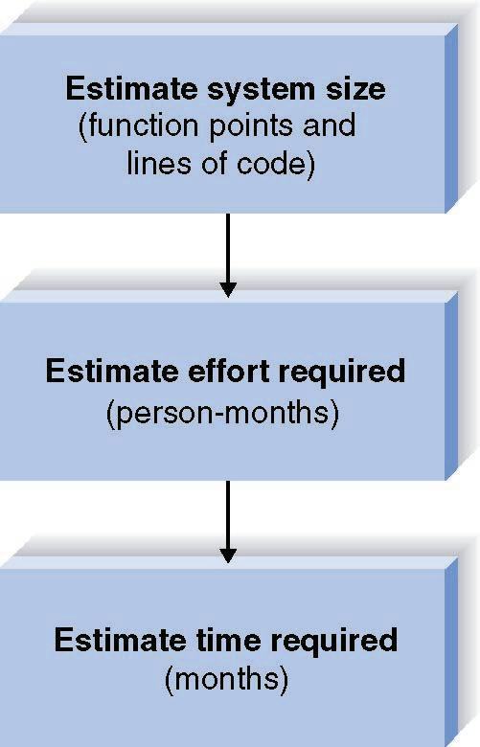
Time Estimation Using a More Complex Approach

Slide 26
Estimation Trade-offs
Size
  Function points
  Lines of code
Effort
  Person-months
Time
  Months

Slide 27
Getting the Right Numbers for Estimation
Prior projects
  Past experience
  Industry standards

Slide 28
Function Point Estimation
Complexity
Description Low Medium High Total
Inputs __x 3 __x 4 __x 6 ____
Outputs __x 4 __x 5 __x 7 ____
Queries __x 3 __x 4 __x 6 ____
Files __x 7 __x 10 __x 15 ____
Program __x 5 __x 7 __x 10 ____
Interfaces
TOTAL UNADJUSTED FUNCTION POINTS ____

Slide 29
Function Points Estimation
Total Adjusted Function Points
= Adjusted Project Complexity * TUFP
Complexity = (0.65 -- 1.35)

Slide 30
Converting Function Points to
Lines of Code
Language
LOC/Function Code Point
C
COBOL
JAVA
C++
Turbo Pascal
Visual Basic
PowerBuilder
HTML
Packages
(e.g., Access, Excel)
130
110
55
50
50
30
15
15
10-40
Source: Capers Jones, Software Productivity Research

Slide 31
Estimating Effort
Function of size and production rate

Slide 32
COCOMO Estimation Calculation
Effort = 1.4 * thousands-of-
(in Person- lines-of-code
Months)
Example:
If LOC = 20.000 Then...
Effort = (1.4 * 20) = 28 Person Months

Slide 33
Estimating Schedule Time
Rule of thumb for estimation
Schedule Time (months)
=
3.0 * person-months^{1/3}

Slide 34
Staffing Attributes
Staffing levels will change over a project’s lifetime
Adding staff may add more overhead than additional labor
Using teams of 8 -10 reporting in a hierarchical structure can reduce complexity

Slide 35
Timeboxing
Fixed deadline
Reduced functionality, if necessary
Fewer “finishing touches”

Slide 36
STAFFING THE PROJECT

Slide 37
Staffing
How many people
Role of each
Minimize conflict
Motivation

Slide 38
Key Definitions
The staffing plan describes the kinds of people working on the project
The project charter describes the project’s objectives and rules
A functional lead manages a group of analysts
A technical lead oversees progress of programmers and technical staff members

Slide 39
Conflict Avoidance Strategies
Clearly define roles and project plans
Hold individuals accountable
Project charter listing norms and groundrules
Develop schedule commitments ahead of time

Slide 40
Motivation
Use monetary rewards cautiously
Use intrinsic rewards
  Recognition
  Achievement
  The work itself
  Responsibility
  Advancement
  Chance to learn new skills

Slide 41
Staffing Plan
Role Description Assigned to
Proj mgr oversees Proj Tom
System anal
.
.
.

Slide 42
CONTROLLING AND DIRECTING THE PROJECT

Slide 43
Refining Estimates &Tracking Tasks
Managing Scope & Risks

Slide 44
Refining Estimates:
Margins of Error in Cost and Time Estimates
Typical margins of Error for
Well-done Estimates
Deliverable Cost (%) time (%)
Project Plan 100 25
Source: Boehm et al. (1995)

Slide 45
Managing Scope & Risk
Scope creep
Actions to reduce risk

